Slide 1
Top Three National Parks in USA
Visitation Analysis
Nattanai Na Songkhla | Ram Sabyrkulov | Ibtisaam Javid Dalvi
Notes:
Hello everyone and thank you for joining us for our presentation
My name is Ram, and today with me Sam and Pack and We are exciting to present you our project
VISITATION ANALYSIS of TOP 3 National Parks in US

Slide 2
Agenda
Introduction & Analysis Question
Data Description & Preprocessing
Methodology
Analysis Results
Part 1 - Regression Analysis
Part 2 - Spectral Analysis
Conclusion
Notes:
In our presentation today we are going to talk about:
What inspired us for our project and questions that we tried to answer
Data that we used and preprocessing steps we took
Methodology that we followed
Analysis that we conducted including Regression analysis and Spectral Analysis
Our results and conclusion

Slide 3
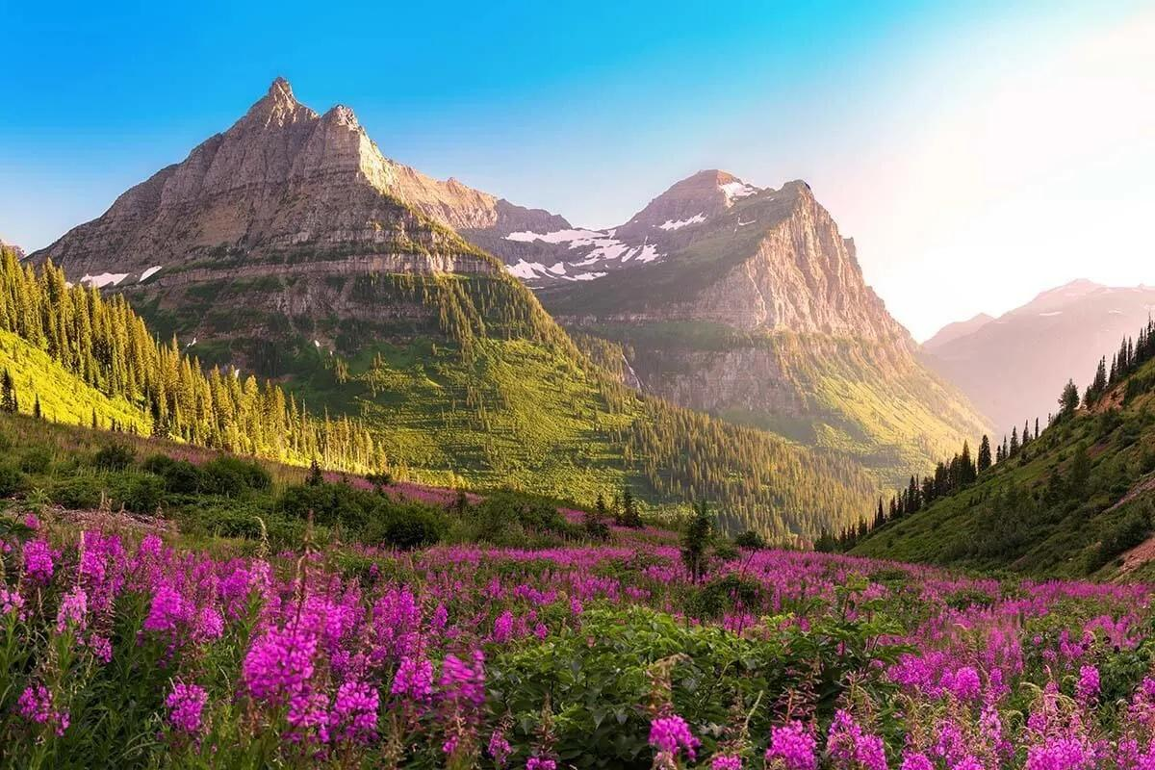
Introduction
Our team are nature enthusiasts and were inspired to conduct a time series analysis and find helpful data insights that could help us understand and predict the dynamics of visitor trends in the top three national parks in the USA.
The primary focus of our study is to analyze and forecast the monthly visitor count for each park.
We will include weather and gasoline prices to help understand the dynamics of the visitors better.
Predictions can aid in efficient park management, resource allocation, and enhancing visitor experiences.
Notes:
As you can see, we are very diverse team, and one of the things we have in common is
PURE LOVE and Passion for nature
That inspired us to conduct a time series analysis to find insights to better understand and predict the monthly visitor count for each park
To help us better understand it, we included WEATHER and GASOLINE prices as independent variables
We believe that accurate predictions can aid in efficient park management, resource allocation, and enhancing visitor experiences.

Slide 4
Analysis Question
What will be the monthly visitor count for each of the top three national parks in the next 5 months?
How will the climate change affect the parks visitation?
Does gasoline price affect the number of parks visitors?
Notes:
Here are top three questions that we had in our minds while working on this project
What will be the monthly visitor count for each of the top three national parks in the next 5 months?
How will the climate change affect the parks visitation?
Does gasoline prices affect the number of parks visitors?

Slide 5
Data Collection
Monthly number of National Park Visitors from 2000 - 2022
(Source: National Park Service )
Average Temperature in Fahrenheit
(Source: NOAA National Centers for Environmental Information website)
Gasoline Price in dollar per gallon ($/gallon)
(Source: Index Mundi website)
Notes:
To collect the data for our variables we visited the following websites:
For national parks: We collected data from National parks Services website, we focused on monthly number of visitors starting from 2000 and ending by 2022
For weather: We collected data from NOAA National Centers for Environmental information website. We focused on average temperature in Fahrenheit.
For Gasoline prices: We collected data from Index Mundi website, and focused on gasoline prices in dollars per gallon.

Slide 6
Methodology
Data Preprocessing
ACF/PACF plot
Regression model on with and without lag
Model Comparison and Forecasting the next 5 month
Spectral Analysis
Fourier Transformation
Periodogram estimation
Notes:
Here are the methodology we followed in our project:
Data Preprocessing
ACF/PACF plot
Regression model with and without lag
Model Comparison and Forecasting the next 5 month
Spectral Analysis
Fourier Transformation
Periodogram estimation plots

Slide 7
Data Preprocessing
Select only top 3 National Parks visitors number (Yellowstone, Yosemite, Grand Canyon), together with specific temperature of each state in Fahrenheit (WY, CA, AZ)
Transform date and time data frame format into time series data
Normalized the year data by difference of 2011
Split data between year 2000-2020 as a train set, and 2021-2022 as a test set
Notes:
In our data preprocessing step:
We selected only top three national parks visitors numbers for Yellowstone, Yosemite, and Grand Canyon
With specific weather temperature of each state where park located
We transformed date and time DATA FRAME FORMAT into time series data format
We normalized the year data by difference of 2021
For regression analysis, we split the data into train set, containing years between 2000 to 2020
And TEST set containing years from 2021-2022.
And now, Sam will walk you through Regression analysis, thank you Sam

Slide 8
Analysis A - Regression Analysis

Slide 9
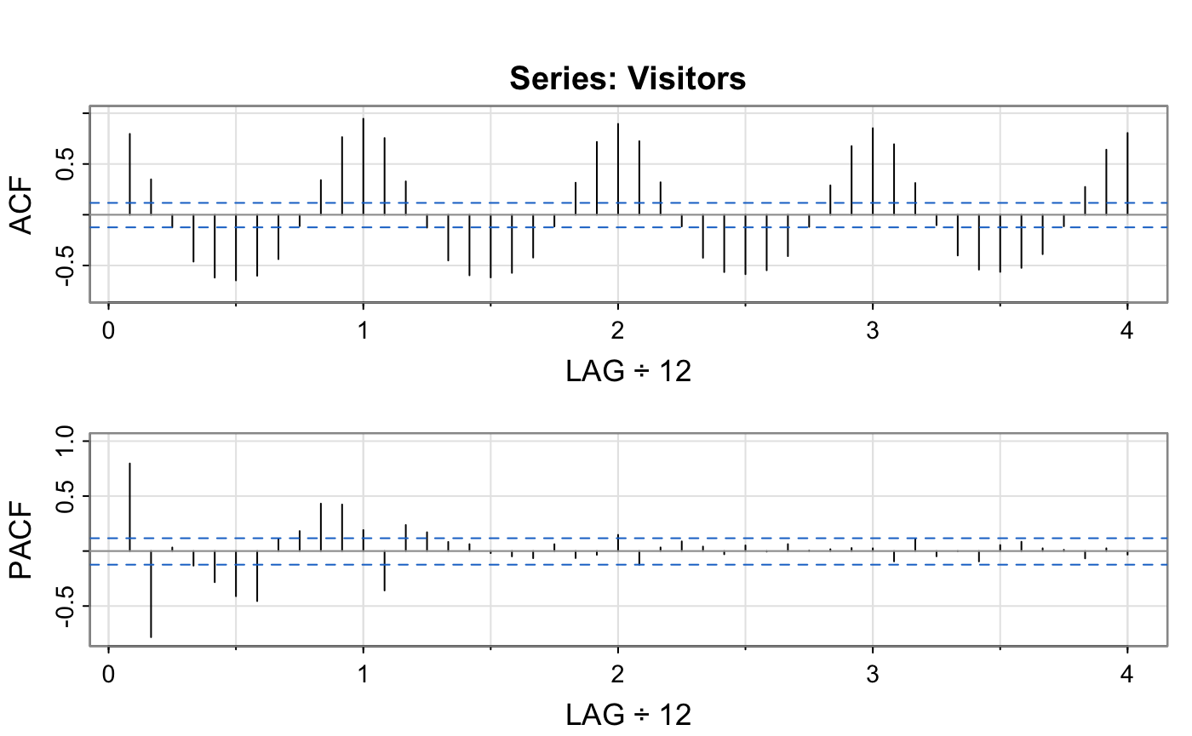
ACF/PACF
We observe seasonal lag of 12 month , then we decide to introduce lag-12 into our model.
Notes:
Helloo

Slide 10
Regression Model
We try 2 regression models with and without lag-12 for each parks
visitors ~ year + month + temp + gasoline_price
visitors ~ year + month + temp + gasoline_price + lag-12

Slide 11
Regression Model Comparison
National Parks | Model | R2 | RMSE | AIC | BIC
Yellowstone | lag | 0.9815 | 178267.2 | 5843.666 | 5902.837
 | w/o lag | 0.968 | 136159.9 | 6241.677 | 6298.085
Yosemite | lag | 0.8974 | 68378.27 | 5996.685 | 6055.856
 | w/o lag | 0.8989 | 85304.81 | 6261.561 | 6317.969
Grand Canyon | lag | 0.8193 | 90129.46 | 6116.406 | 6175.577
 | w/o lag | 0.8084 | 95837.91 | 6405.864 | 6462.271
** Overall: model with lag-12 performs better

Slide 12
Regression Result
National Parks | Significant Parameter | LB-test residuals (p-value)
Yellowstone | year month lag-12 | 2.048e-13
Yosemite | month | < 2.2e-16
Grand Canyon | gasoline price lag-12 | < 2.2e-16
** All failed to reject null of independently distributed

Slide 13
Forecast Results (JAN - MAY 2023)
National Parks | Value | JAN | FEB | MAR | APR | MAY
Yellowstone | forecast | 56,540 | 59,450 | 38,741 | 79,912 | 475,826
 | real | 45,709 | 45,717 | 30,044 | 69,247 | 454,262
Yosemite | forecast | 149,965 | 159,811 | 191,209 | 265,351 | 378,542
 | real | 107,256 | 107,012 | 25,005 | 205,802 | 322,308
Grand Canyon | forecast | 200,278 | 207,000 | 394,630 | 433,321 | 486,099
 | real | 134,361 | 151,395 | 326,916 | 457,189 | 492,037
** Model seems to be slightly overprediction

Slide 14
Analysis C - Spectral Analysis

Slide 15
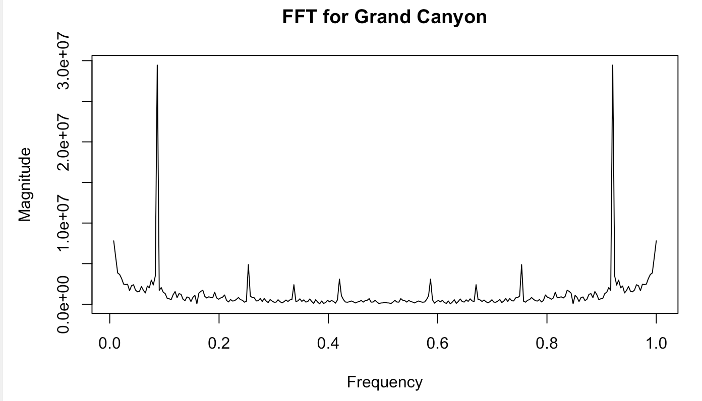
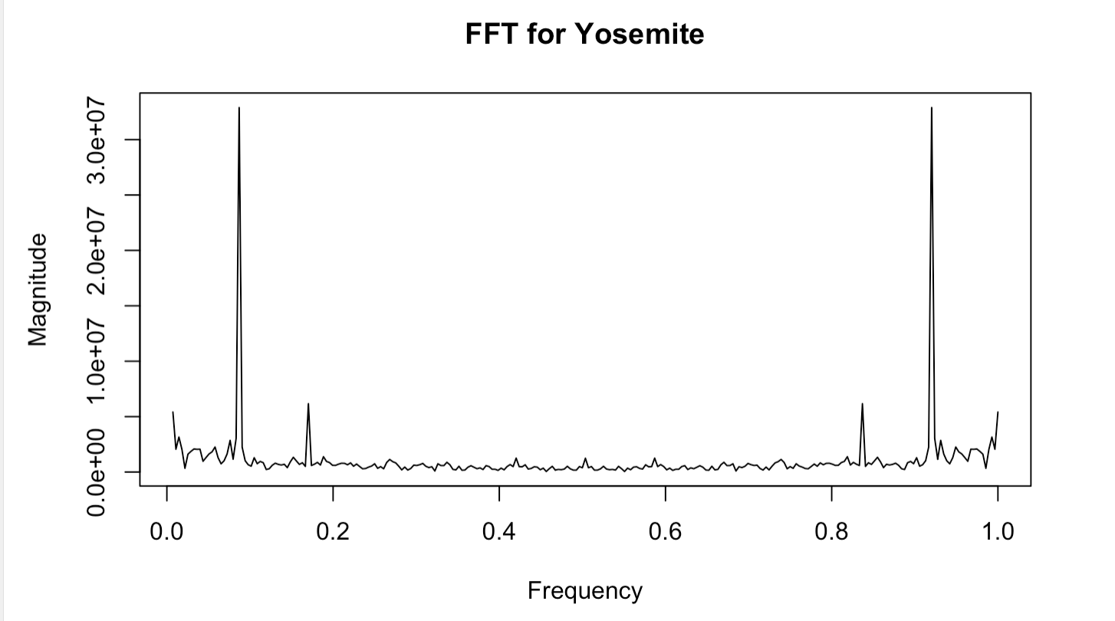
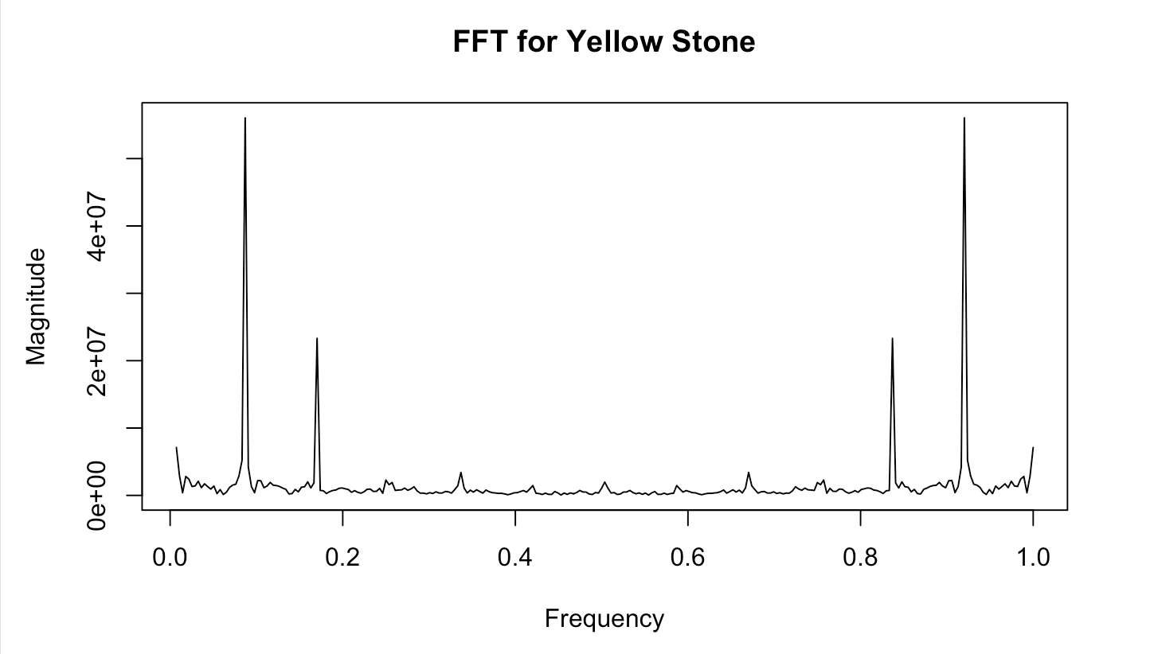
Fast Fourier Transformation
The peaks in the plot tell us the presence of a strong frequency component within the data. We see the dominant annual pattern of visitors due to one high peak in the year.

Slide 16
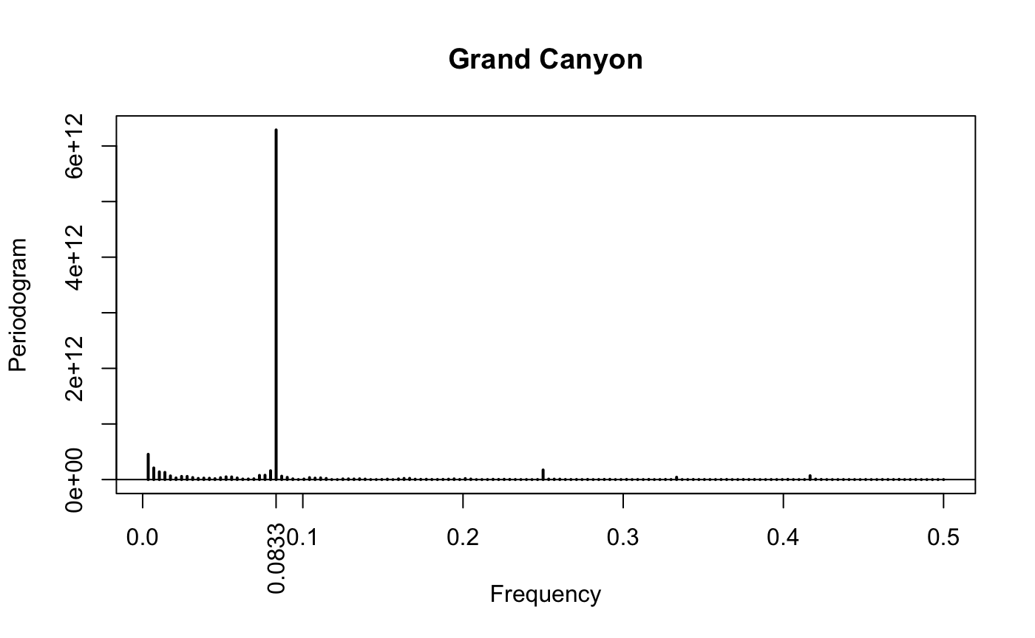
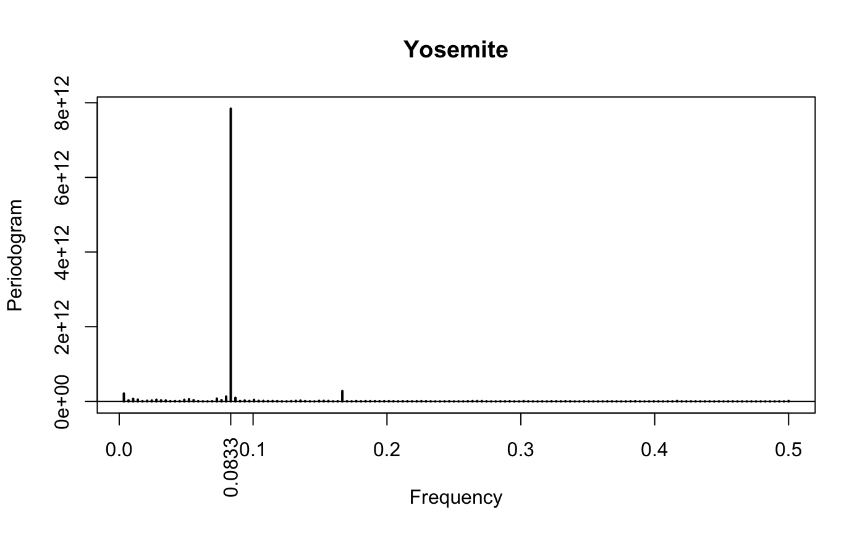
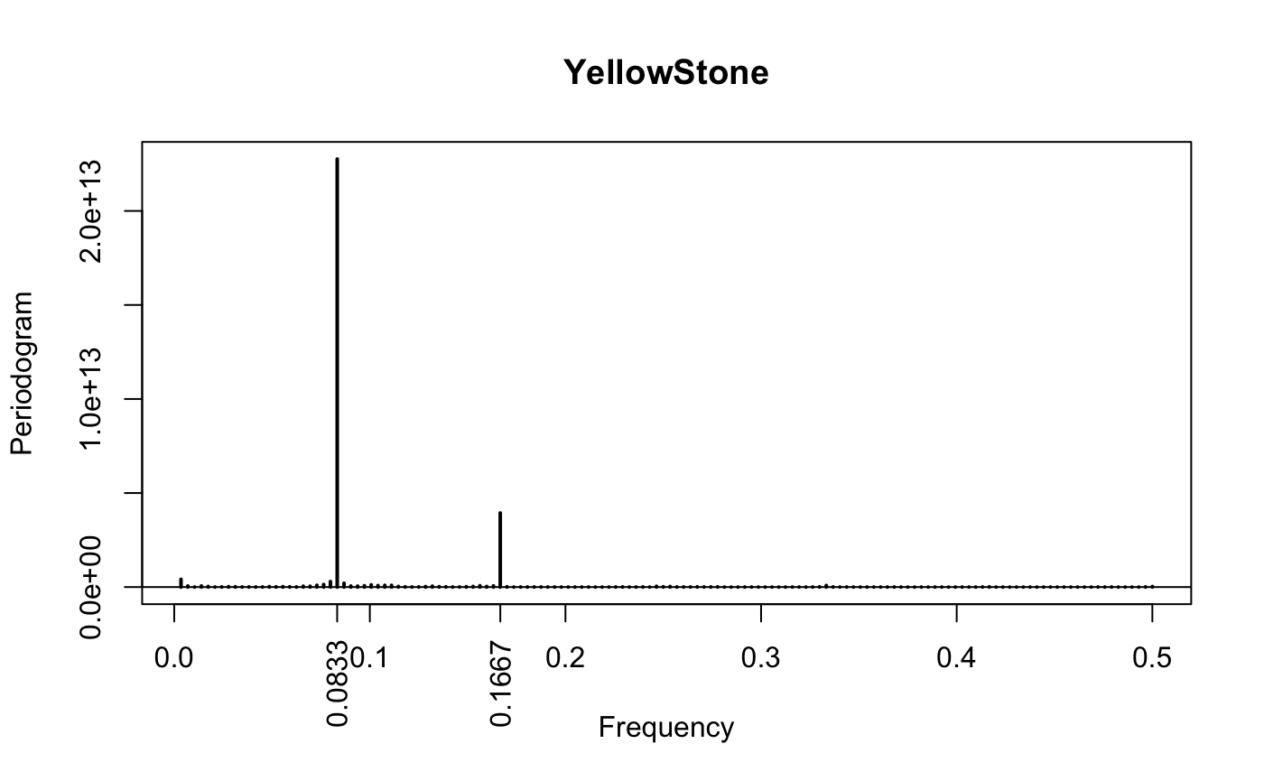
Periodogram
** All show the main frequency of 0.0833 (which is 1/12 or annually trend)

Slide 17
Overall Summary
Model with lag-12 performed better with an OOS R^2 greater than 0.8, with a slightly overprediction for the next 5 months forecast.
Temperature seems to be not significantly affect for visitation number predictions, while gasoline price is significant for only Grand Canyon national park.
Our spectral analysis indicates that all three national parks show the main frequency of 0.0833 that confirms the annual cycle in visitor numbers.

